Slide 1
Data analysis on Crime Data
T. Insight.
Heesu Yeom (Hallym univ. senior)
Jeongmyeong Choi (Hallym univ. senior)
Jongyoon Chae (Konkuk univ. junior)
Beomseok Cho (Konkuk univ. junior)
Hyojin Jeon (Konkuk univ. junior)
Jaeyoung Kim (Hallym univ. senior)
Data from :
https://data.lacity.org/A-Safe-City/Crime-Data-from-2010-to-Present/63jg-8b9z

Slide 2
Index
Word Cloud
Data Reliability
Data preprocessing using python / Represent using R
Data analysis
Development potential

Slide 3
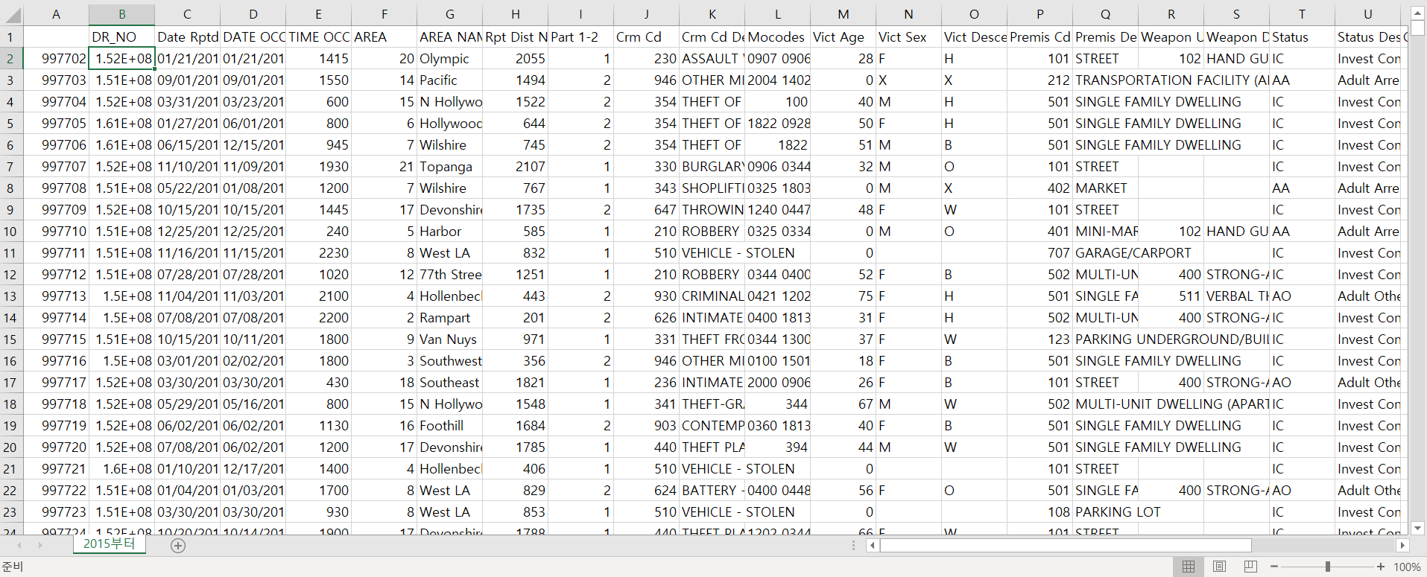
Crime Data On LA

Slide 4
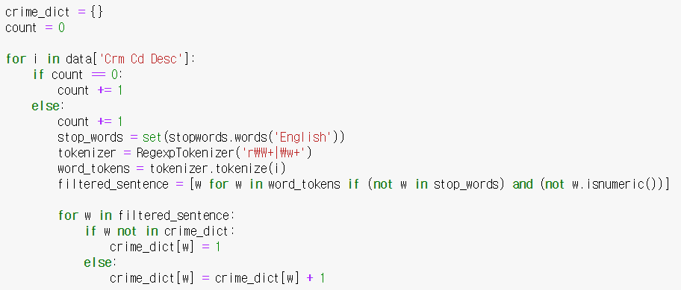
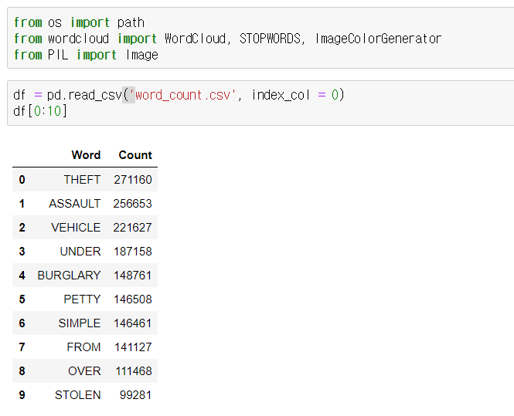
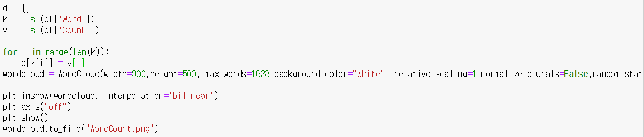
Python Code

Slide 5
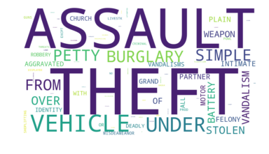
Word Cloud

Slide 6
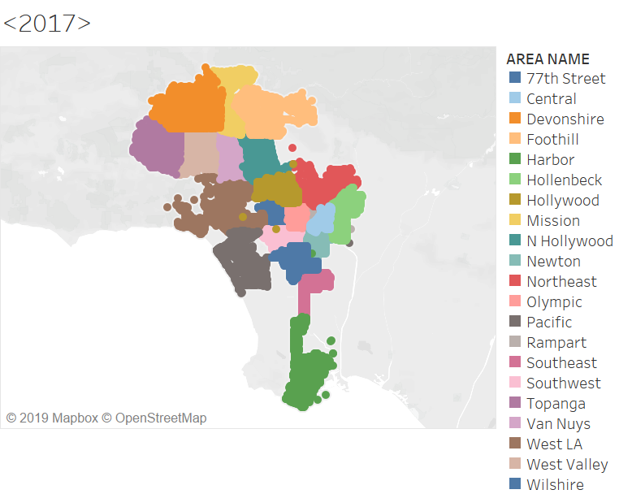


Data Reliability
Similar occurrence pattern → we can trust our presumption!

Slide 7
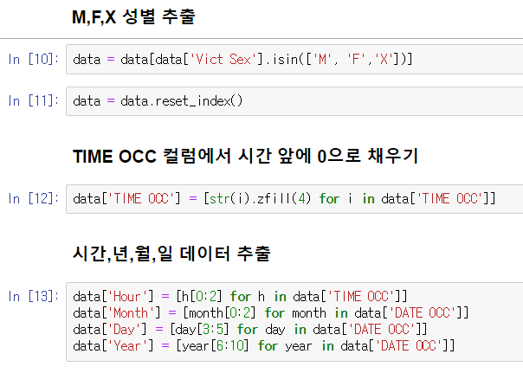
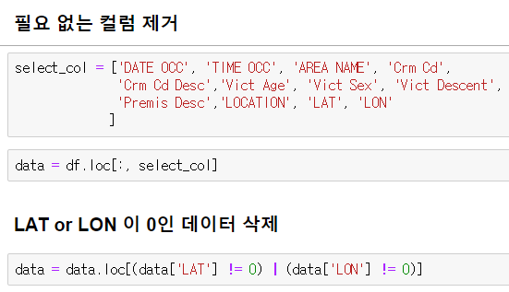
Data Preprocessing

Slide 8
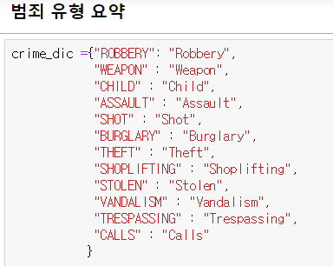
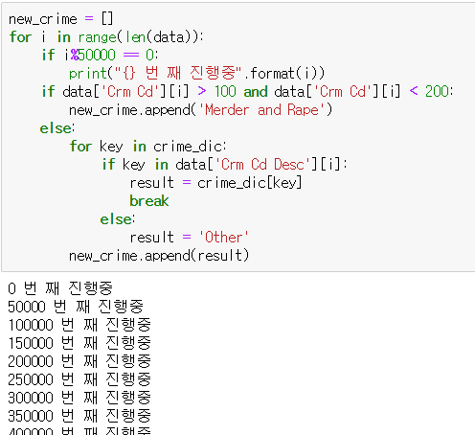
Data Preprocessing

Slide 9
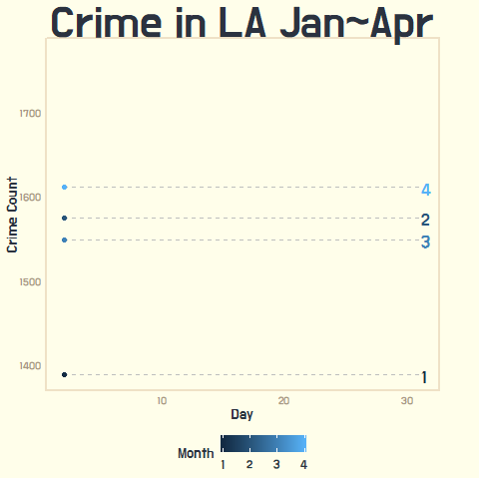
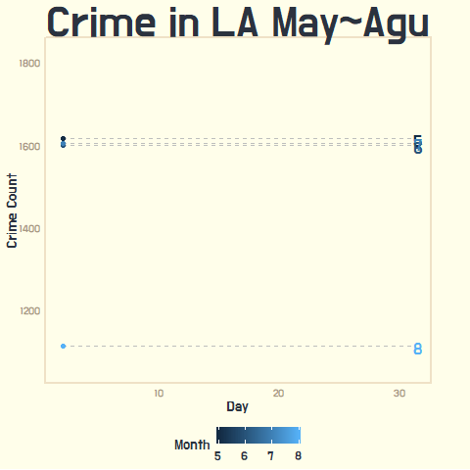
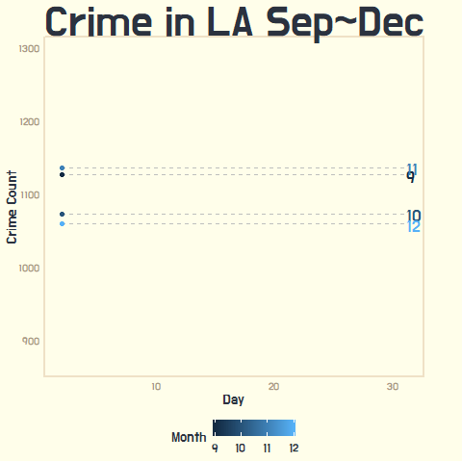
Data Analysis (1)

Slide 10
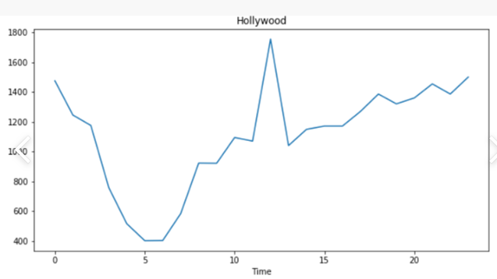
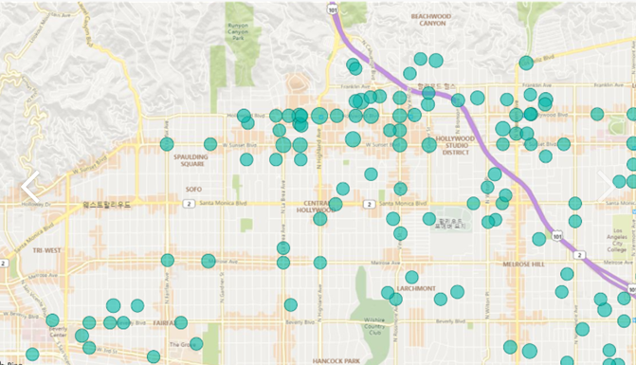
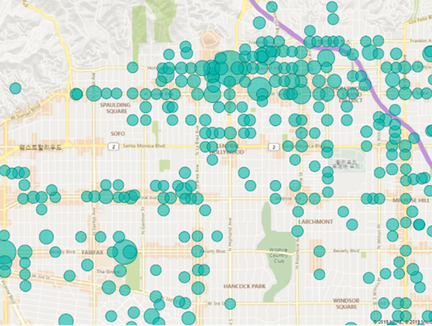
Data Analysis (2)
06:00 am
12:00 pm

Slide 11
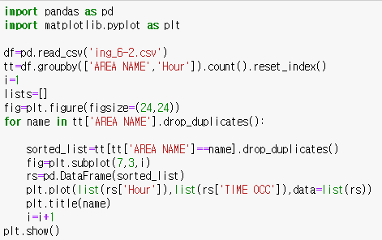
Data Analysis (2)-1

Slide 12
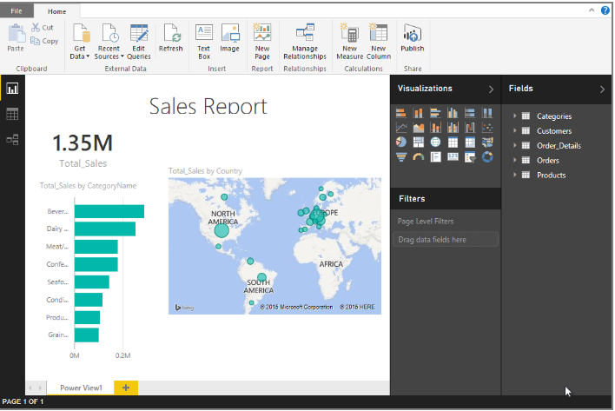
Data Analysis (2)-2
06:00 am
12:00 pm

Slide 13
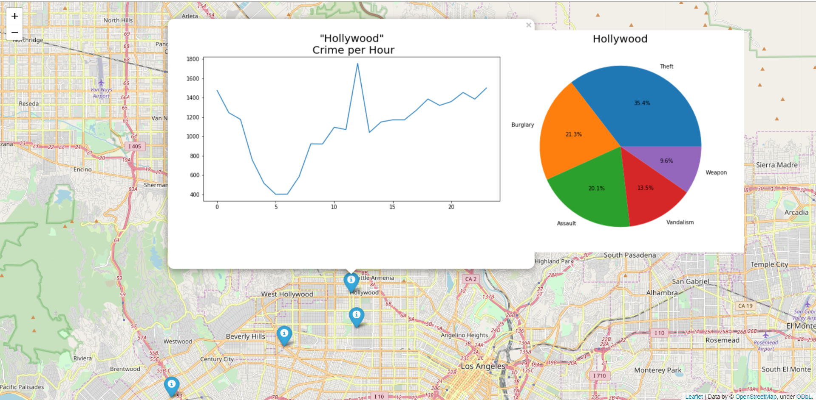
Data Analysis (3)

Slide 14
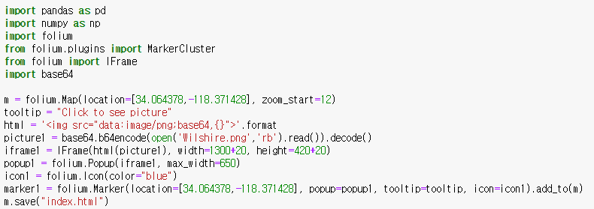
Data Analysis (3)

Slide 15
HOW IS IT USEFUL?
1. Social values - Visitor safety
: Visitors can refer to our analysis for choosing where and when to go sightseeing.
2. Economical values –Efficient administration
:Useful information to place officers efficiently

Slide 16
Furthermore
How can it be developed more?

Slide 17
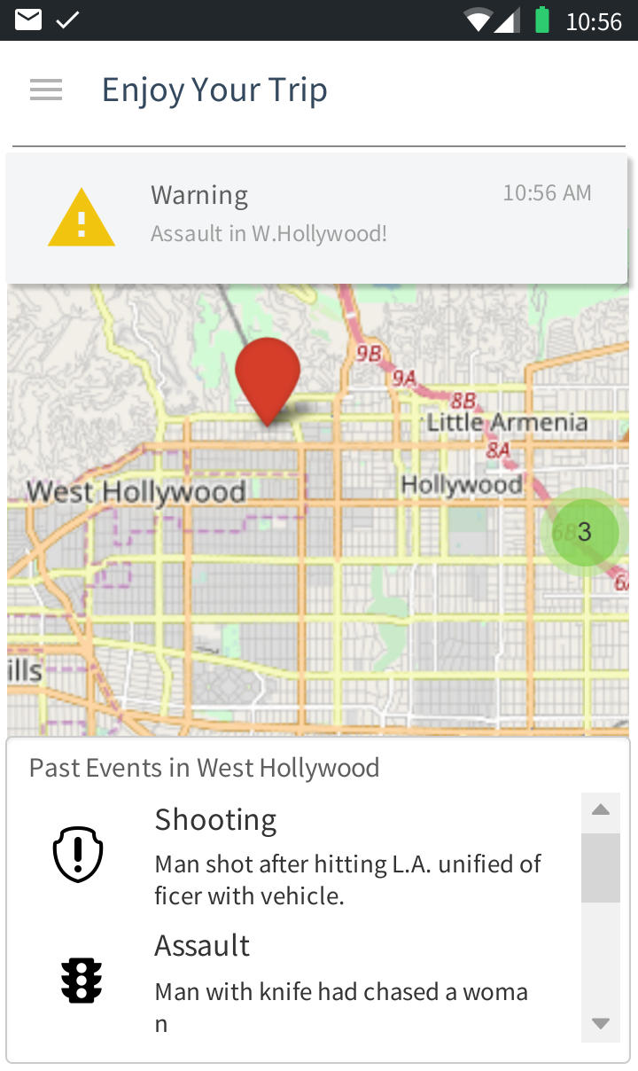
How can it be developed more?
[Application for L.A. Visitors]
1.Users can post their accidents and get others’ information in real-time.
2.Alert accidents to user near the event in real-time.
(application example )→

Slide 18
THANK YOU

